Slide 1
Environmental Insurance in a “Hardened” Traditional World: Lessons of Cost Cap use at EPA’s 1st Site Reuse Award Site, & PLL Use for 2018’s Largest Brownfield presentation to Society of Environmental Insurance Professionals (Boston; October 9, 2019)

Slide 2
Michael Hill
Environmental Attorney (1986-present)
DOJ Trial Attorney (1986-1990);
Associate and Partner in large firm (1990-2000) (clients included largest EI purchaser, pioneer of FPCs);
Principal at Alba (law firm & brokerage) (2004-present).
Environmental Insurance Broker (2002-present)
National Leader then Chair of Marsh’s Envir. Practice (world’s largest); and
Principal at Alba (2004-present).
Environmental Client (1998-2002; 2010-2012)
Counsel for, then Senior Vice President of, TRC (1998-2002)
COO & General Counsel of $773M GM Trust (world’s largest envir. remediation and rdvpt. Trust) (2010-2012, while also at Alba)
U.S. Gov’t. Contractor (2005-present):
Created the Cost Cap & PLL alternatives to be discussed today.

Slide 3
Emergence/Growth of Captive Insurance
1981: 1st U.S. statute. Today, >30 states have statutes.
2016:
>7,000 captives worldwide (over 90% of Fortune 1,000 companies have them, as do many smaller companies, non-profits, and associations). Used primarily for 1st layers of General Liability, Workers Comp, etc.)
Property & Casualty premiums to captives exceed that of all Traditional Insurers.
In 2018, Vermont’s captives alone had $22.6B in premium and $196B in assets.

Slide 4
Captive v. Environmental Insurance (1980-2019)
Uninsured Risks
(e.g., Cost Cap; much of PLL & CPL; LLC & other transferee insolvencies; climate change effects; carbon credits & other climate-supporting products, etc.)
Captive Insur.
2011 (all Insurers formally exit Cost Cap mkt.)
Envir. Insur.
2016 (P&C premiums to Captives exceed those of all Trad’l. Insurers; AIG exits PLL mkt.)
1980
1990
2000
2010
2020

Slide 5
Misc. Captive Req’ts. and Advantages
Must be a valid insurance company, formed for valid business purpose.
Particularly suited to environmental in light of 1984 GL full exit, then 2011 (Cost Cap) exit and 2016 (PLL) hardening.
Customizable (e.g., periods >10 years; tailored exclusions).
Premiums (and premium taxes) lower.
Deductible (if meet risk-shifting requirements), and tax on growth possibly deferred.
Direct access to reinsurers.
If no claims, premiums and capital return to Owner.
Added credibility with SEC, EPA, and others. (espec. w “fronting”)
Terms known up front (e.g., at time that PSA, remediation and other contracts are bid).

Slide 6
Standard v. Trad’l. Environmental v. Captive Insurance
Standard: 99% of policies (e.g., Home; Auto; GL; not Envir.)
On regulator-approved templates.
Insureds negotiate only the limits, deductible, premium, etc.
Environmental Insurance
As a “surplus line” product, no regulatory review of terms.
On commercial templates, but can negotiate all terms, but within limits of Insurer’s appetite (e.g., 10 yr. max; PFAS?).
Captive Insurance (Envir. and other):
Regulator review to ensure actual risk distribution, but no templates (other than those owner(s) or sponsoring cell manager may want to offer as “head start”).
Can negotiate all (e.g., 30-yr. max; PFAS; climate; carbon credits)
Sec. 831(b) “Micro” Captives (<$2.2M prem./yr.) likely large enough for most cleanups.

Slide 7
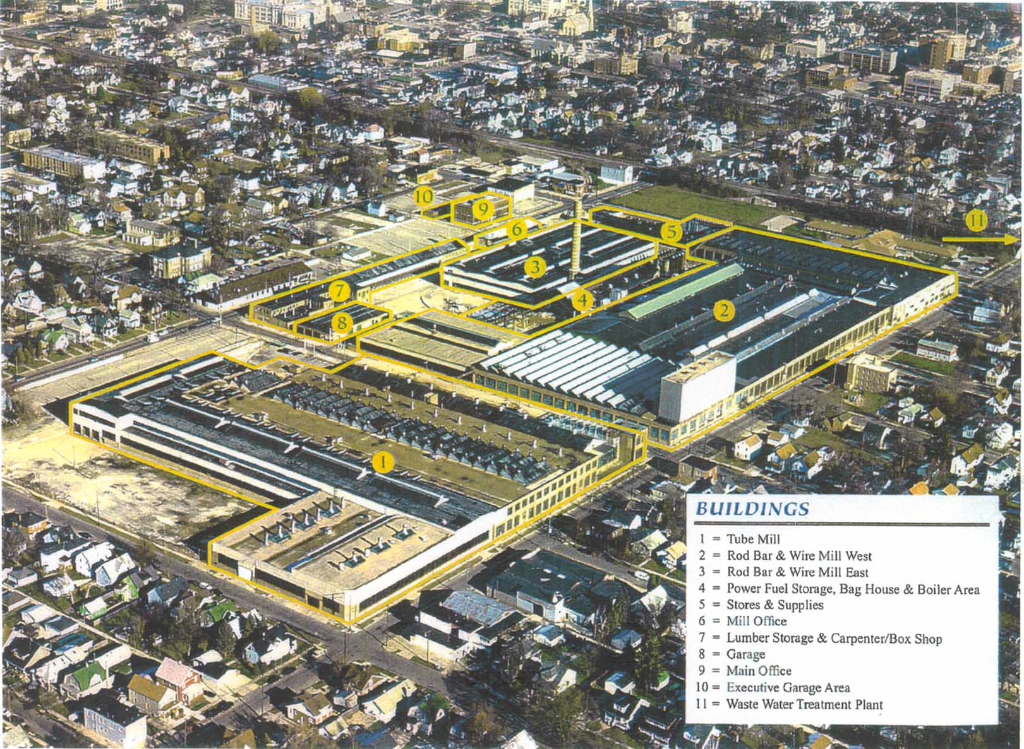
Best Years of Envir. Insur. (1998-2004) (e.g., 2002-2032 Policy for BP, Kenosha & TRC)
Two conventional estimates, with no guarantee: $15-$20M.
Insured FPC done for $10.1M.
Contractor covered “all environmental regulatory” risks.
AIG covered >90% of regulatory risks and nearly 100% of non-regulatory).
$5M via Brownfield grants and Tax Incremental Financing.
Owner reduced its cost to $5.1M and left jobs- and tax-generating asset to City.
*Reference: C. Olson, R. Bursek, and M. Jones, Urban Renaissance: From Brass Manufacturing To Uptown Brass Center, Air & Waste Mgt. Ass’n. (Dec. 2005).

Slide 8
One Word Can Make A Difference (E.g., Additional Insured v. Additional Named Insured)

Slide 9
Too Many Words Can Make A Difference
E.g., Mare Island Naval Shipyard
KPC definition >1,000 words; incentives misaligned (e.g., no “sticks” for contractor).
>100% over budget and >400% beyond schedule (all of $57M Cost Cap and much of $150M PLL exhausted).
Years of Dvpr.-Contractor disputes, then of insurance litigation.

Slide 10
Overview (Cost Cap, PLL & CPL)
CPL (Contractor’s Pollution Liability) applies for costs caused by Contractor (e.g., through negligence). As with all environmental insurance, language is unregulated and must be reviewed and negotiated.

Slide 11
Traditional Cost Cap (early 2000’s v. now)
Minor Exclusions
(covered by Contractor)
Not Offered
Covers All Regulatory Claims Arising from all Pollutants Identified in RAP or discovered in course of executing RAP
Early 2000’s
2011 to present

Slide 12
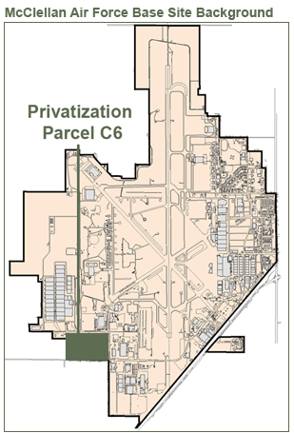
1st Use of Cost Cap Alternaitve (used by Recipient of EPA’s 1st Annual Site Reuse Award)
Parcel C6 ($11M; 62 acres) 1st privatized cleanup at NPL via FOSET, and 1st completed (2007, 2009)
FOSET #1 ($14M; 545 acres) (2010)
FOSET #2 ($16M; 528 acres) 1st use of Cost Cap Alternative. EPA approved and applauded. (2012)
FOSET #3 ($20M; 207 acres) (2015)
Details of mechanics: M. Hill, Insured Fixed-Price Cleanups: Still Possible Even After Commercial Insurers’ 2011 Exit from the Cost Cap Market, 70 CWLR 955 (Oct. 2015).
Award Announcement: https://www.afcec.af.mil/News/Article-Display/Article/1653015/epa-honors-afcec-team-at-former-mcclellan-air-force-base-with-national-site-reu/

Slide 13
2017 PLL (v. 2018 PLL + Escrow)
Major Exclusions
Minor Exclusions
v.
+
City PLL (2017)
City-USG PLL (2018)_
Escrow Supplement
(2018)

Slide 14
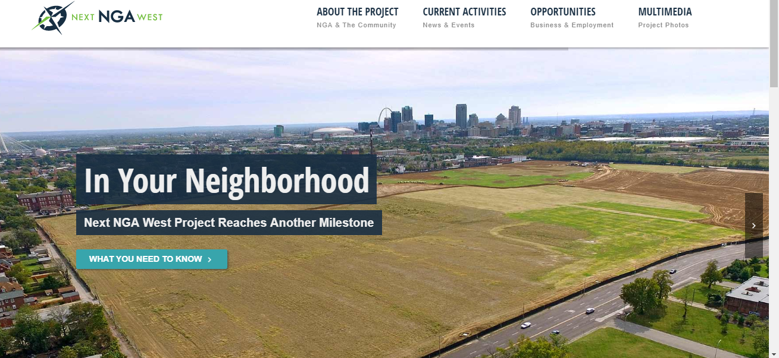
PLL-Alternative; Used in 2018 for $2B Brownfield Redevelopment
Transfer of 97 acres from City to USG. 2017 PLL excluded all pollutants in fill, discovered during rdvpt. and/or already known even if only at safe levels). 2018 PLL omitted the above exclusions, and supplementing escrow covered remaining PLL-type risks. Transfer occurred Dec. 2018; Rdvpt. Underway; 3,000 jobs expected.

Slide 15
Example of Today’s “Hardened” PLL Market (LRA Broker cannot get PLL quote even for investigation)

Slide 16
Much Remains to be Quantified & Controlled
E.g., USG identifies its own Envir. Liabilities as among its Highest Risks:
Grew 220% from 1997 to 2017 ($212B to $465B);
U.S. GAO emphasized need for better cost estimates and controls.
*GAO, High Risk Series, GAO-19-157SP, at 138-39 (March 2019)

Slide 17
Fixed Price Cleanups as Means to Quantify, Lower & Control Costs
Aligns Contractor and Owner goals. Results:
Lower Costs:
Average costs 21% below Independent Government Estimates (34% below Costs-To-Complete estimates).
Faster Cleanups:
Contractors are meeting or beating schedules.
Better Quality: “At all installations, the quality of work has been reported from good to going beyond requirements.”
Source: USAEC, Tracking Performance on the Army’s Performance-Based Contracts, at 4, 24, 31 (May 16, 2006) (available in course materials); see also EPA IG, EPA Should Increase Fixed-Price Contracting for Remedial Actions, Rept. No. 13-P-0208, at 14 (March 28, 2013). Compare R. Durant, The Greening of the U.S. Military, 1, 4 (2007) (“DOD inspector general has found that average cleanup costs at closing bases are typically 60 percent higher than estimated originally.”).

Slide 18
Overview of Fixed-Price Cleanups
Contractor assumes all environmental regulatory liabilities up to 2X expected costs based on a determined fixed price
Big carrot: Contractor keeps 100% of all savings under expected cost
Big sticks: Contractor responsible for
1st 20% of overruns
15% of remaining 80% of overruns
Insurer pays
68% of regulatory cost overruns from KPCs
100% of regulatory and non-regulatory costs from UPCs
Although USG and many large PRPs can self-insure, Contractors require insurance as condition of meaningful Fixed Price Contract (i.e., FPCs without change orders)

Slide 19
Time and Material Contracts Historically
Cost Overruns
(Self-Insured
by AF)
Contractor profit 13%, paid by AF
Overruns
Total AF liability
Initial Remediation Contract
Held and paid
by AF
Initial Contract
AF Perspective
Contractor Perspective

Slide 20
$2.6M
$.78M
$1.3M

Slide 21
Incentive Alignment by FPC and Insurance
(Can “Beta” Test)
AF Self-Insuring
($10M)
Contractor ($1.2M)
AF Self-Insuring ($6.8M) (68%)
Contractor ($.96M)
AF Self-Insuring ($5.44M) (68%)
Contractor ($.96M)
Insurance Reserves ($5.44M) (68%)
$10M
Contractor ($2M)
$8M
Expected Cleanup Costs
($10M)
Expected Cleanup Costs
($10M)
Contractor ($1.6M)
$.82M
Contractor ($1.6M)
Expected Cleanup Costs
($8M)
Premium
Expected Cleanup Costs
($8M)
$10M
$8M
Traditional (T&M)
FPC wo Insur. & wo Mkt. Incentives
FPC wo Insur. but
with Mkt. Incentives
FPC with Insur. and
with Mkt. Incentives

Slide 22
Post-2011 FPCs, Using Cost Cap Alternative
Contractor ($.96M)
Escrow ($5.44M) (68%)
$8M
($.3M)
Escrow
($1.7M) (43%)
($.3M)
Escrow
($1.7M) (43%)
Contractor ($1.6M)
$4M
Contractor ($1.6M)
Contractor ($1.6M)
Expected Cleanup Costs
($8M)
Expected Cleanup Costs
($8M)
Expected Cleanup Costs
($8M)
$8M
$8M
FPC Insured to 2X w Cash
FPC Insured to 1.5X w Cash
FPC Insured to 1.5X w LOC

Slide 23
Contractor’s Incentives/Risk Profile (at 2X)
(i.e., why Contractors should like true FPCs)
Break-even Point: $11,494,253

Slide 24
Owner Costs v. Contractor Profits (FPC v. T&M Models)
Owner Costs & Contractor Profits ($MM)
$1.3M
$4.78M
Costs to Reach NFA ($MM)
(-$.6M)

Slide 25
Captive Options
Single-Entity Captive covering multiple risks including Environmental
Group Captive covering Envir. Risks of Multiple Insureds
Single-Entity Captive covering only Environmental Risks
Sponsored Cell Captive
Single-Entity’s Envir. Risks
Single-Entity’s Envir. Risks
Single-Entity’s Envir. Risks

